Slide 1


Slide 2

#LifeKoKaroLift
SGC Coaching:
Articulate your Journey | Activate Students’ Vigour| Accelerate Mutual Growth
Session -4
Data Exploration and Preparation

Slide 3
Agenda
Quick Recap –(10 mins)
Focused Discussion –(50 mins)
Doubt resolution –(30 mins)
Last 2 weeks
Exploratory Data Analysis through examples
Review - Notebooks
Notes:
Exact time will depend on the learner’s background and skills.

Slide 4
Recap: What the learner have learnt in the week
Exploratory Data Analysis
Data Inspection
Analysis variables
Univariate Analysis
Bivariate Analysis
Categorical vs. continuous
Multivariate Analysis
Data Cleaning
Pruning missing values
Outliers treatment
Check logical errors
Filter relevant data
Data Source: Public/private
Data distribution
Checking Columns (Measurement Scale)
Dealing with data size
Visual Analysis
Visual Plotting
Which chart type to use?
Root cause Analysis
Highlighting key insights
Notes:
Measurement scale for columns: Whether they are Nominal, Ordinal, Interval or ratio?
Simple numerical analysis for value distribution

Slide 5
Focussed teaching: Points of Investigation
Bi-Variant Analysis
Deep Dive on the right target
Missing Value
Outlier Treatment
Variable Transformation

Slide 6
Focussed teaching: Bi-variate Analysis
Bi-variate Analysis finds out the relationship between two variables. Here, we look for association and disassociation between variables at a pre-defined significance level
Combinations
Continuous & Continuous
Categorical & Categorical
Categorical & Continuous
Notes:
https://www.analyticsvidhya.com/blog/2016/01/guide-data-exploration/#:~:text=Prediction%20Model%3A%20Prediction%20model%20is,method%20for%20handling%20missing%20data.&text=First%20data%20set%20become%20training,is%20treated%20as%20target%20variable.

Slide 7
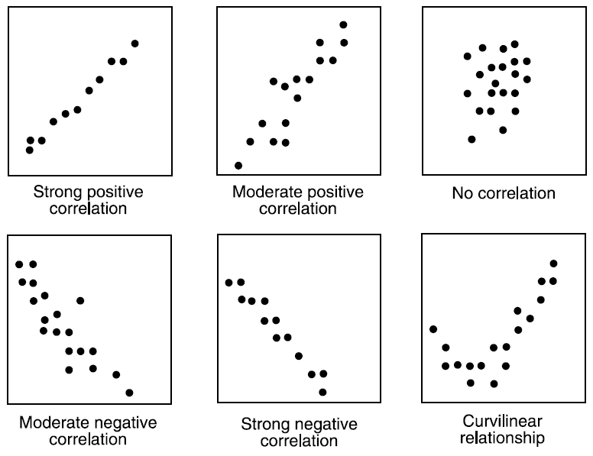
Focussed teaching: Bi-variate Analysis
Continuous & Continuous
Notes:
https://www.analyticsvidhya.com/blog/2016/01/guide-data-exploration/#:~:text=Prediction%20Model%3A%20Prediction%20model%20is,method%20for%20handling%20missing%20data.&text=First%20data%20set%20become%20training,is%20treated%20as%20target%20variable.

Slide 8
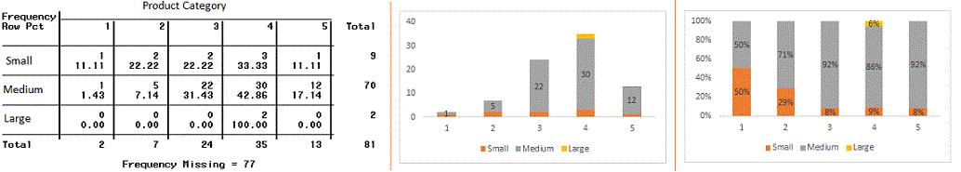
Focussed teaching: Bi-variate Analysis
Categorical & Categorical
Two-way table
Stacked Column Chart
Notes:
https://www.analyticsvidhya.com/blog/2016/01/guide-data-exploration/#:~:text=Prediction%20Model%3A%20Prediction%20model%20is,method%20for%20handling%20missing%20data.&text=First%20data%20set%20become%20training,is%20treated%20as%20target%20variable.

Slide 9
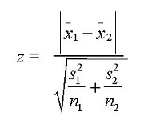
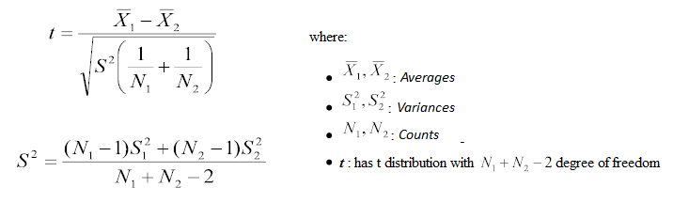
Focussed teaching: Bi-variate Analysis
Categorical & Continuous
T-test/z-test
ANOVA
Notes:
https://www.analyticsvidhya.com/blog/2016/01/guide-data-exploration/#:~:text=Prediction%20Model%3A%20Prediction%20model%20is,method%20for%20handling%20missing%20data.&text=First%20data%20set%20become%20training,is%20treated%20as%20target%20variable.

Slide 10
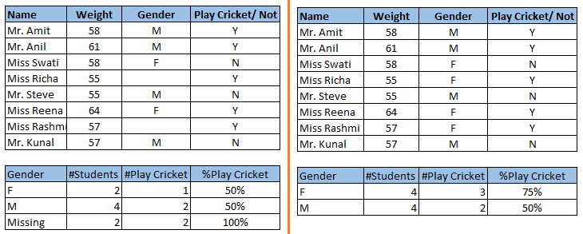
Focussed teaching: Missing values treatment
Missing values treatment:
Deletion
Mean/ Mode/ Median Imputation
Prediction Model
KNN Imputation
Notes:
https://www.analyticsvidhya.com/blog/2016/01/guide-data-exploration/#:~:text=Prediction%20Model%3A%20Prediction%20model%20is,method%20for%20handling%20missing%20data.&text=First%20data%20set%20become%20training,is%20treated%20as%20target%20variable.

Slide 11
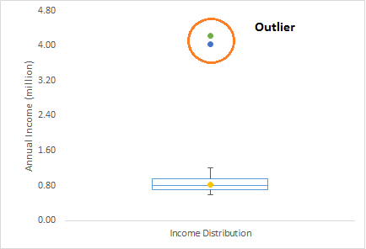
Focussed teaching: Outlier treatment
Outlier is an observation that appears far away and diverges from an overall pattern in a sample.
Treatment
Deleting observations
Transforming and binning values
Imputing
Treat separately
Notes:
You can choose your own examples too for illustrations

Slide 12
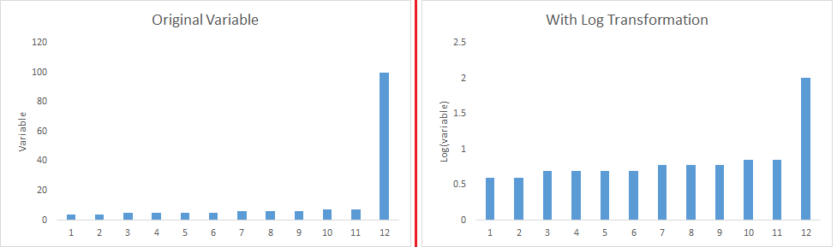
Focussed teaching: Variable transformation
Logarithm
Square / Cube root
Binning
Notes:
You can choose your own examples too for illustrations

Slide 13
Deep-dive/ Targeted Analysis
Target hotspots instead of the whole data
E.g. Top 250 movies as per IMDB rating
E.g. Top 10 Highest grossing movies
Profiling the target based on key factors:
Clustering the movies based on Directors
Grouping actors by critic and user ratings
Classifying by languages, genres, etc.
Why? It helps the analyst focus on the most critical problems instead of navigating through entire data.
How?
Use data subsets, groupby aggregations and create tables/ bars to illustrate the importance by factors.
Actor | num_critic | num_user
Leonardo DiCaprio | 330.190476 | 914.476190
Brad Pitt | 245.000000 | 742.352941
Meryl Streep | 181.454545 | 297.181818
Genre1 | Genre2 | Gross
Family | Sci-Fi | 435
Adventure | Sci-Fi | 229
 | Family | 119
 | Animation | 117
Action | Adventure | 110
Notes:
The are examples taken from IMDB assignment which they have completed. It will help them connect the dots easily.
More Coverage for Business Analysts will be preferable

Slide 14
Focussed teaching: Let’s Code Together
Coding Time

Slide 15

Doubt resolution
Questions??

